Slide 1

Text Classification Using DistilBERT
A Deep Learning Approach to Categorizing Text Efficiently

Slide 2
NAME | REG.NO | CRANES REG.NO
Anu Rani | 2201020318 | CL20250106019291122
Arpita Mishra | 2201020383 | CL2025010601924576
Aryajeet Debapriya | 2201020384 | CL2025010601924677
Avipsha Swain | 2201020387 | CL20250106018936118
Subham Tarasia | 2201020743 | CL20250106019293124
Team
Members

Slide 3

Introduction
Project: Text Classification Using DistilBERT
Objective: Automatically classify text into predefined categories using deep learning.
Why It Matters: Rapid growth of unstructured text data on the internet demands scalable NLP solutions.
Applying Transfer Learning for Efficient NLP Solutions

Slide 4
To develop a deep learning-based solution for automatic text classification using transformer models.
To leverage DistilBERT, a lightweight and efficient version of BERT, for high-performance NLP tasks.
To demonstrate the power of transfer learning in handling real-world, labeled text data.
To build an end-to-end pipeline that includes data preprocessing, model training, evaluation, and prediction.
To create a model that is scalable, accurate, and suitable for deployment in practical applications.
Objective of the Project

Slide 5
Text Classification
DistilBERT
It is the process of assigning predefined categories to pieces of text.
Common applications include:
Spam detection
Sentiment analysis
Topic tagging
Intent recognition
A smaller, faster, and lighter version of BERT developed by Hugging Face.
Retains 97% of BERT's language understanding performance.
Trained using a technique called knowledge distillation.
Ideal for real-time or resource-limited environments.
Provides efficient contextual embeddings for deep NLP tasks like classification.

Slide 6
Works with your own labeled text data
Cleans and prepares text automatically
Uses DistilBERT to understand the meaning of text
Trains a model to classify text into categories
Tests how well the model performs
Can predict the category of new text
Fast and easy to use
Can be added to websites or apps
Good for real-time and mobile use
Can be improved for more languages and labels
FEATURES

Slide 7
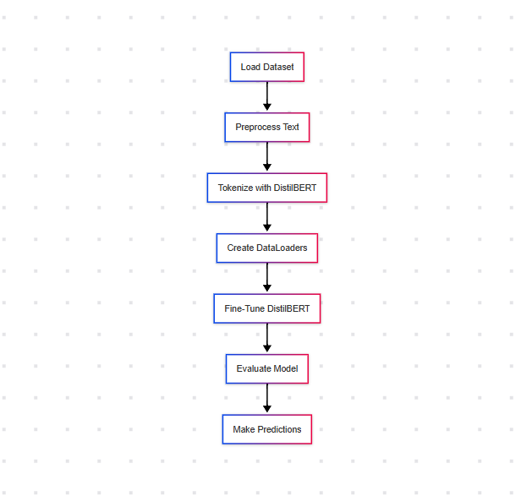
Flowchart

Slide 8
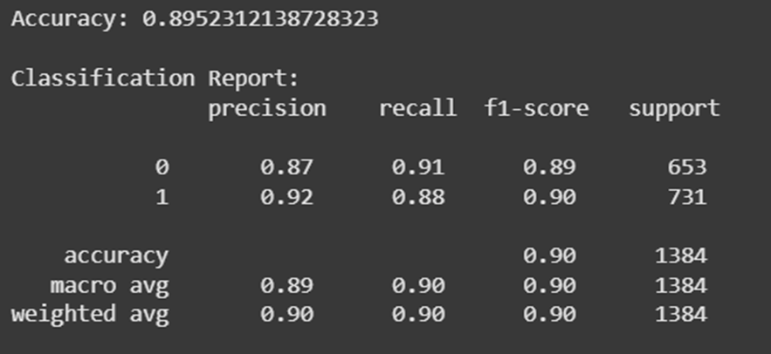
Evaluation Metrics

Slide 9
Domain | Application
E-commerce | Product review analysis
Healthcare | Categorizing medical reports
Social Media | Sentiment & trend monitoring
Finance | Customer support classification
Journalism | News topic classification
Real-World Applications

Slide 10

Advantages of the Project
Lightweight and fast
High accuracy on classification tasks
Easy integration and fine-tuning
Scalable to different text classification problems
Can be deployed in real-time systems

Slide 11

Add support for multi-label classification.
Train on larger, more diverse datasets.
Deploy as API or mobile/web application.
Use Multilingual DistilBERT.
Interactive dashboards using Streamlit
Future Scope

Slide 12
This project shows how powerful transformer models like DistilBERT can be used for text classification.
By using transfer learning, we saved time and resources while still achieving high accuracy.
The end-to-end process—from preprocessing to prediction—makes the solution ready for real-world use.
With further improvements like larger datasets, multilingual support, and API integration, this project can be scaled for many practical applications.
Conclusion
“ Leveraging Transformers for Smarter Text Understanding “

Slide 13
Thank You

